Slide 1
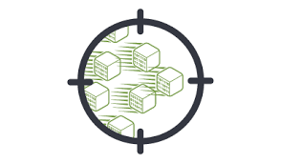

PACKET CAPTURE
PRESENTER: GUIDE:
HANEESH - 2010030323 Dr.P Lalitha Surya LAHARI - 2010030372 Kumari
MOUNIKA - 2010030384
RITHVIK - 2010030421

Slide 2

ABSTRACT:
This presentation contains the detailed description of the project “Packet Capture”
Packet Capture refers to the action of capturing Internet Protocol (a set of rules which says how data should be delivered) packets that travel across the network layer of the Internet Protocol layer for review or analysis.
A full packet includes two things: a payload and a header. The payload is the actual contents of the packet, while the header contains metadata, including the important data such as the source,destination address, packet type and size, and related details.
After packet is captured in, it is stored for a period of time so that it can be analyzed.
Once the raw packet data is captured, the packet sniffer analyzes it and presents it in a readable form so that the person using the software can understand it. The person analyzing the data can view details of the interaction between two or more nodes on the network.
This information is to determine where a fault lies, such as determining which device failed to respond to a network request.

Slide 3

Nowadays, As more people communicate through Internet, network has grown tremendously and become more complex. This has lead to a challenge to protect the network from any threats and solve the network problems. Hence, It is used for network troubleshooting and communication protocol analysis. This system is useful for a network administrator who needs to identify, diagnose, and solve network problems like a company manager who wants to monitor user activities on the network and ensure that the corporation’s communications assets are safe, or a consultant who has to quickly solve network problems for clients.
INTRODUCTION

Slide 4
KEYWORDS:
Packet capture
Packet sniffer
Network traffic
Troubleshooting Network
Internet Protocol

Slide 5
LITERATURE REVIEW:
• Identifying security threats
• Troubleshooting undesirable network behaviors
• Identifying network congestion (overcrowding)
• Identifying data/packet loss
Packet sniffer helps to identify, diagnose, and solve network problems. It is difficult to identify the problems if the network traffic is not tracked, users depend on the analyzer provided by the operating system (if any) or the anti-virus software that is installed to provide real-time network security. Hence, it is identified that these systems provide a specific set of reports which helps to troubleshoot and monitor the network.
Our project will be written in Python. It will
capture packets and size of the packet and source and
destination machine IP addresses which are involved in
the packet transferring.

Slide 6
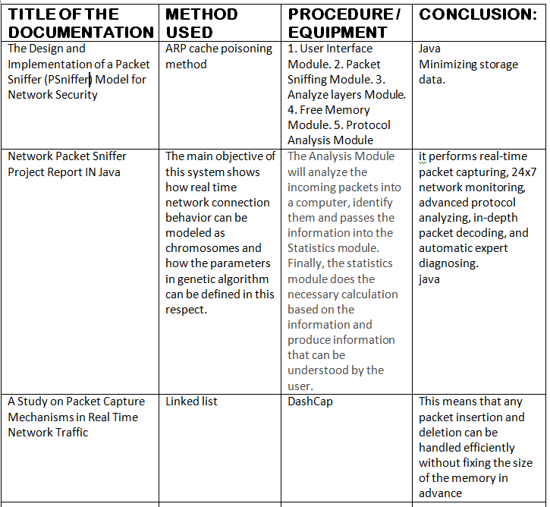
METHOD USED:
Exploring different channels
Key findings
Tips from the experts
Examples
How brands work online

Slide 7
RESULTS:
During this course of study, we found that many problems had been addressed yet storage is one of the primary concerns in a packet capture. Firstly, you can capture packets for a short period of time. Secondly, you can configure a filter to capture only a specific subset of packets.
Finally, you can use external storage drives to keep files of captured packets. This last option is especially useful for those that want to keep backups of all the traffic flowing through their network.

Slide 8
CONCLUSION:
There are many available tools used to capture network
traffic, but there are limitations in some of the tools. Some
tools only capture network traffic without analysis, while
some require a large memory size for installation therefore
the researcher has to use other tools for analysis to get the
traffic features as required and also consider the memory
size of the system in use.
So, we will try to develop a model where packet capture takes less memory size. It can be used for
network traffic monitoring, traffic analysis, troubleshooting
and other useful purposes.

Slide 9
THANK YOU.

